Slide 1
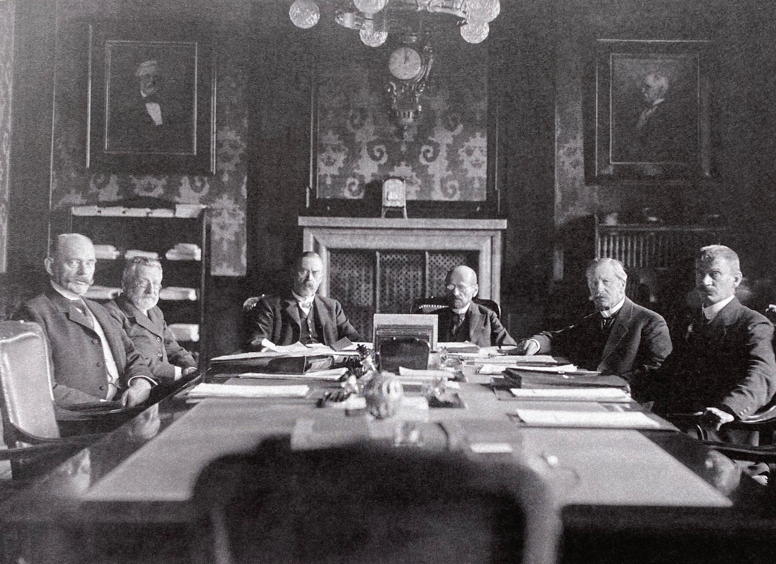
Finding Common Ground?
Attempts at Rebuilding the Scandinavian Monetary Union
in the Interwar Years
Gjermund Forfang Rongved, Associate Professor of Economic History
Inland School of Business and Social sciences, Inland Norway University of Applied Sciences

Slide 2
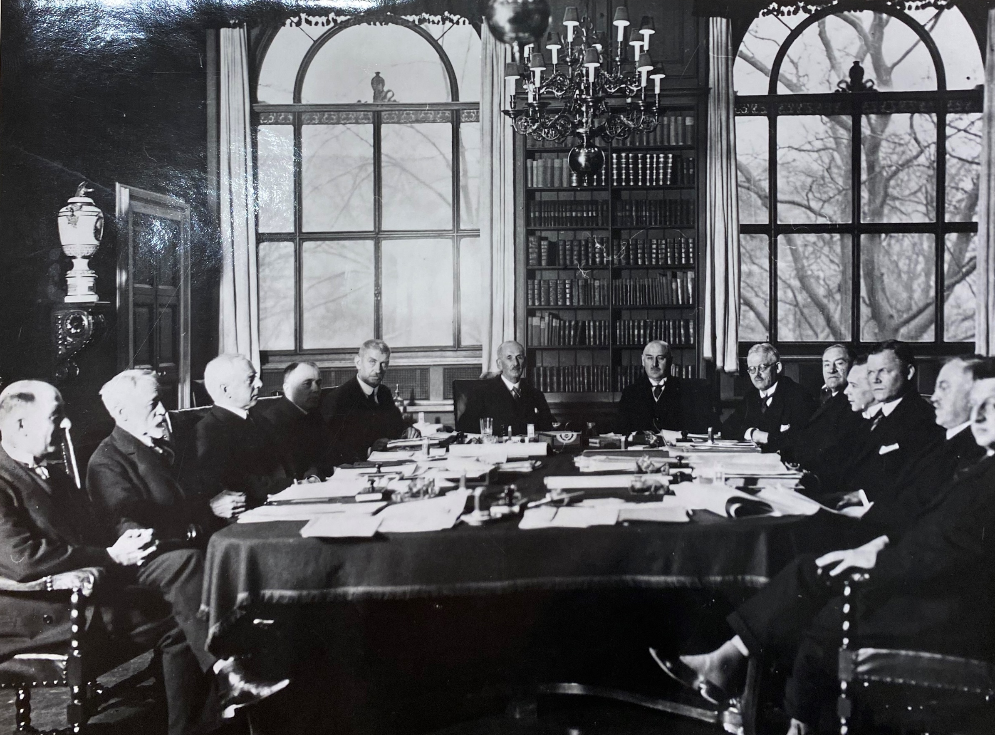


Notes:
Copenhagen 21.-22. February 1931
[Kontorsjef Hammerich]
Director of Nationalbanken, Frits Schrøder
Director of Nationalbanken, Westy Stpehensen
Deputy governor of Norges Bank, Stein Thorkildsen
Governor of Norges Bank, Nicolai Rygg
Director of Nationalbanken, Hans Rosenkrantz
Danish Minister of Commerce, Christen Nielsen Hauge
Danish Minister of Finance, Carl Valdemar Bramsnæs (he became director 5 years later)
Director of the Riksbank, Adolf af Jochnick
Governor of the Riksbank, Ivar Rooth
Director of the Riksbank, Amner
Danish economist Axel Nielsen
[Kontorchef Einar Cohn]

Slide 3
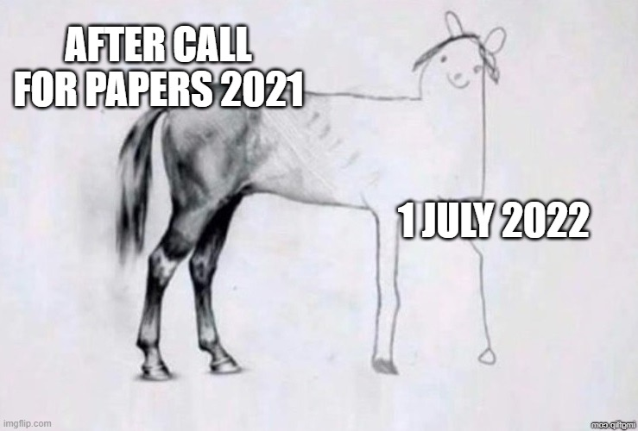
Started of with three research questions
How did the Scandinavian central banks consider the prospects of re-establishing the Scandinavian Monetary Union in the interwar years
In the perspective of central bank independence: Was it the central banks or the governments who were the main advocates of re-establishing the Scandinavian Monetary Union?
In the perspective of isolationism vs. cooperation in the interwar years, and small states vs. Great Power influence more generally: Were the small Scandinavian countries merely followers? (Or: How we are to understand the discrepancy between national economic autonomy, Scandinavian cooperation, and the need to follow the great power lead?)

Slide 4
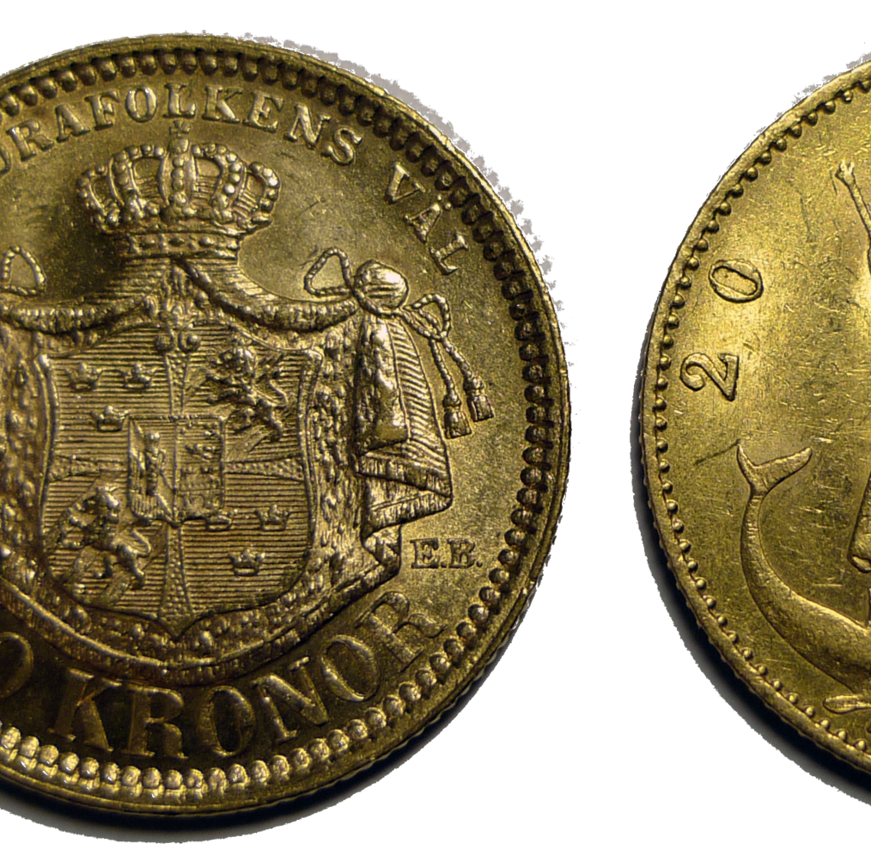
Why this question?
Lots of material in the archives
But theme more or less non-existent in Central bank literature and on the Scandinavian Monetary Union (SMU)
What has been written?
SMU literature: preoccupied with the golden years (1873-1914)
Central bank literature on the interwar years: methodological nationalism

Slide 5
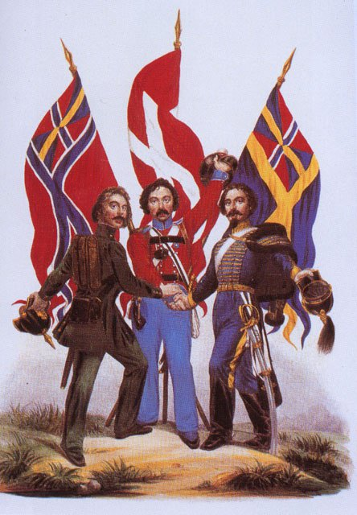
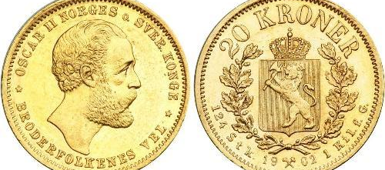
What was the Scandinavian Monetary Union?
Established in 1873/75: Scandinavian Coin Convention
Scandinavianism, universalism, internationalism – and politics + economics
Three currencies (krone/krona) – fixed exchange rates
Gold Standard – main coins 20 and 10 kroner gold (+ non-gold small coins)
Substantial development after 1873/75:
In 1881/1885: bank accounts, and agreement with unlimited feeless drafts at par value
In 1894/1901: accepting each other bank notes at par value
Minor setback in 1905 – but was soon fixed.
Major disruption in 1914 when gold convertibility was suspended

Slide 6
Scandinavian Central Bank Meetings – a «quantitative» view
Year | Type | Cause/theme [to be filled in later] | Location | Date
1916 1916 1917 1918 | SMU meeting SMU meeting SMU Official conference SMU meeting |  | Stockholm Gothenburg Stockholm Copenhagen | 23.-24. Feb 7. Oct 17.-19. Apr 8.-9. May
1918 | SMU meeting |  | Oslo* | 25.-26 Oct
1918 | SMU Official conference |  | Stockholm | November?
1920 | SMU meeting |  | Copenhagen | 9.-11. Feb
1920 | SMU meeting |  | Oslo* | 23.-25. Feb
1921 | SMU meeting |  | ? | Feb.?
1921 | SMU meeting |  | Stockholm | 12.-13. Nov
1921 | SMU meeting |  | Oslo* | 13.-15. Dec
1923 | SMU Official conference |  | Oslo* | 29.-31. Oct
1923 1924 1925 1928 1929 1931 1931 1932 1933 1935 1936 1937 1938 1938 1939 1939 | SMU meeting SMU meeting SMU meeting SMU meeting SMU meeting SMU meeting Nordic meeting SMU meeting Nordic meeting Nordic meeting Nordic meeting Nordic meeting Nordic meeting Nordic meeting Nordic meeting Nordic meeting |  | Stockholm Copenhagen Oslo Stockholm Gothenburg Copenhagen Stockholm Oslo Stockholm Copenhagen Oslo Helsinki Basel Stockholm Basel Copenhagen | 14.-15. Dec 12.-13. Oct 23.-24. Oct 7.-9. Dec 22.-23. Nov 21.-22. Feb. 27. Sep 22.-23. Oct 24.-25. May 25. Feb 25.-26. Oct 27.-28. Sept 10. May 17.-18. Dec. 9. May 14.-15. Oct
No meetings pre 1914
Approx. 30 meetings, 25 in interwar years
SMU meetings
«Nordic meetings» in 1930’s
A handful «Official conferences»

Slide 7
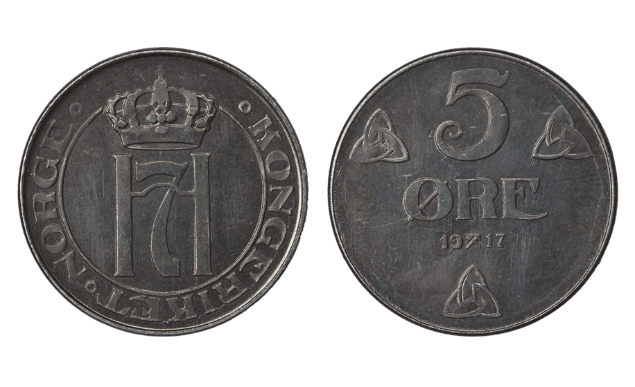
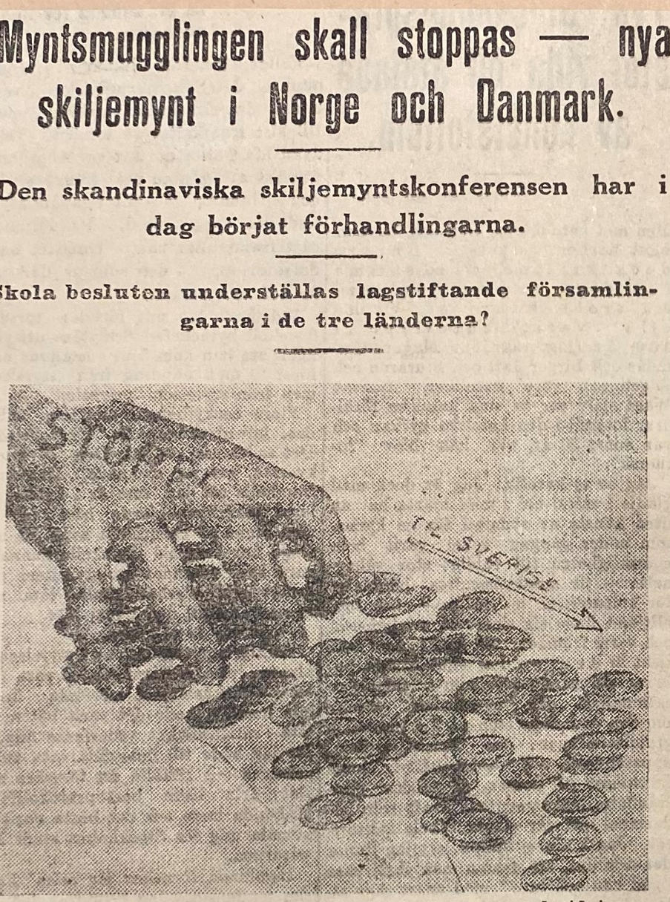
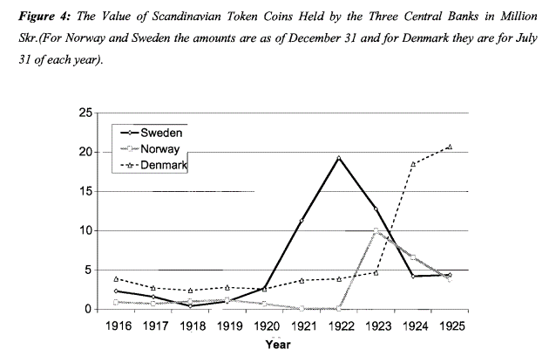
What were the problems re-establishing the union after the First World War?
Difficult relations
Exchange rate discrepancies
Uncertainty concerning the gold standard
National economic problems
Scandinavian Coin Convention
The «Small Non-Gold Coins Problem»

Slide 8
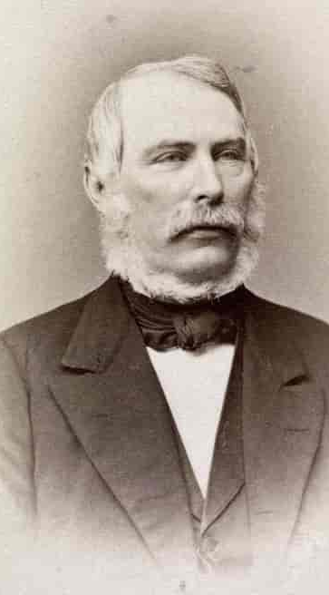
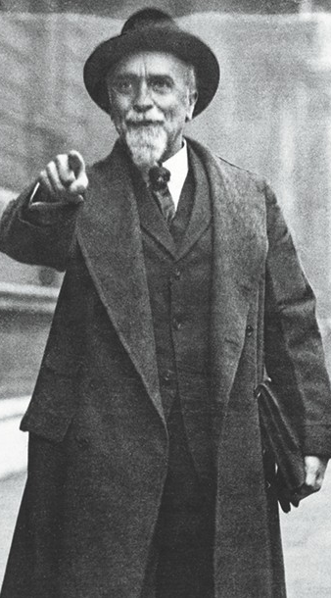
Was solving the small coin problem in 1924 the definitive end of the union?
Three arguments why not:
The SMU was not conditioned by small coins
Just like the gold standard, re-establishing SMU on other terms did not imply it broke down (SMU also a “return to normalcy”)
Quantitative and qualitative findings support this: the actors did not see it as terminated
Can 1924 rather be seen as a new starting point?

Slide 9
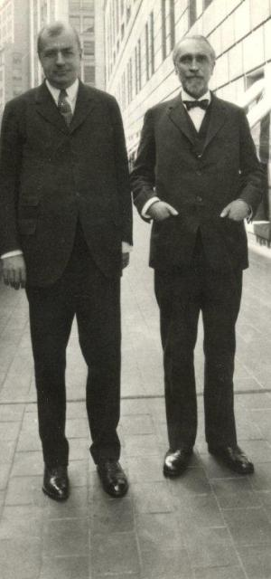
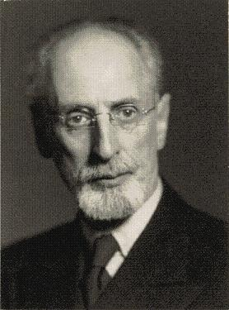
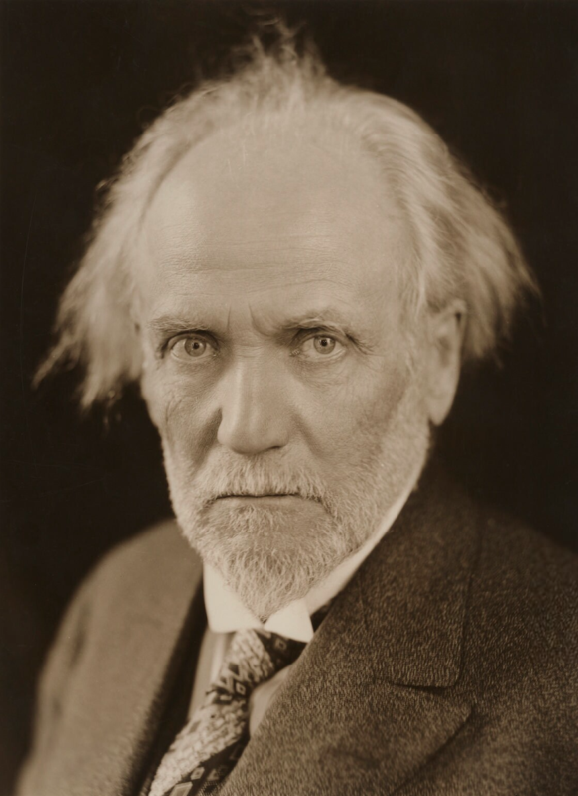
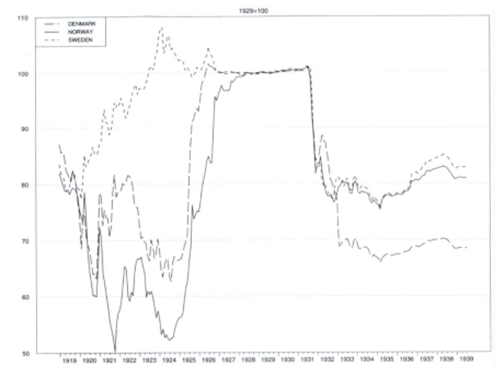
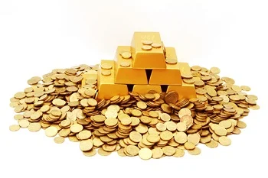
How did the Scandinavian central banks consider prospects of restoring the SMU before returning to gold standard?
Two conditions:
  US and Great Britain taking the lead
  All Scandinavian central banks back on gold
Exchange rate discrepancies
But general will to return to the SMU – continously discussed
Sweden back on gold in 1924 – before Great Britain
Denmark in 1926 – but gold bullion standard (like GB)
Norway in 1928 – but gold coin

Slide 10
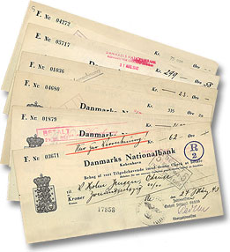
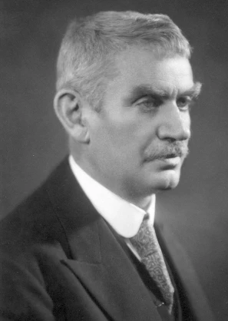
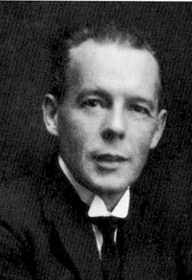
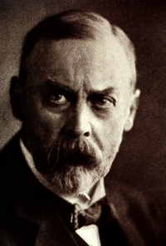
How did the Scandinavian central banks consider prospects of restoring the SMU after returning to gold standard?
All preconditions more or less in place
Dicussions on different kind of union: coin union vs. drafts and central bank notes
Nordic trade meeting strongly in favour; active support from Governor Rygg
December 1928, finally some action: Central bank meeting – working group established (re-establish a «draft union»)
Moll dies - postponement
1930: Draft agreement – but international economic crisis
In 1931: New meeting in Copenhagen

Slide 11
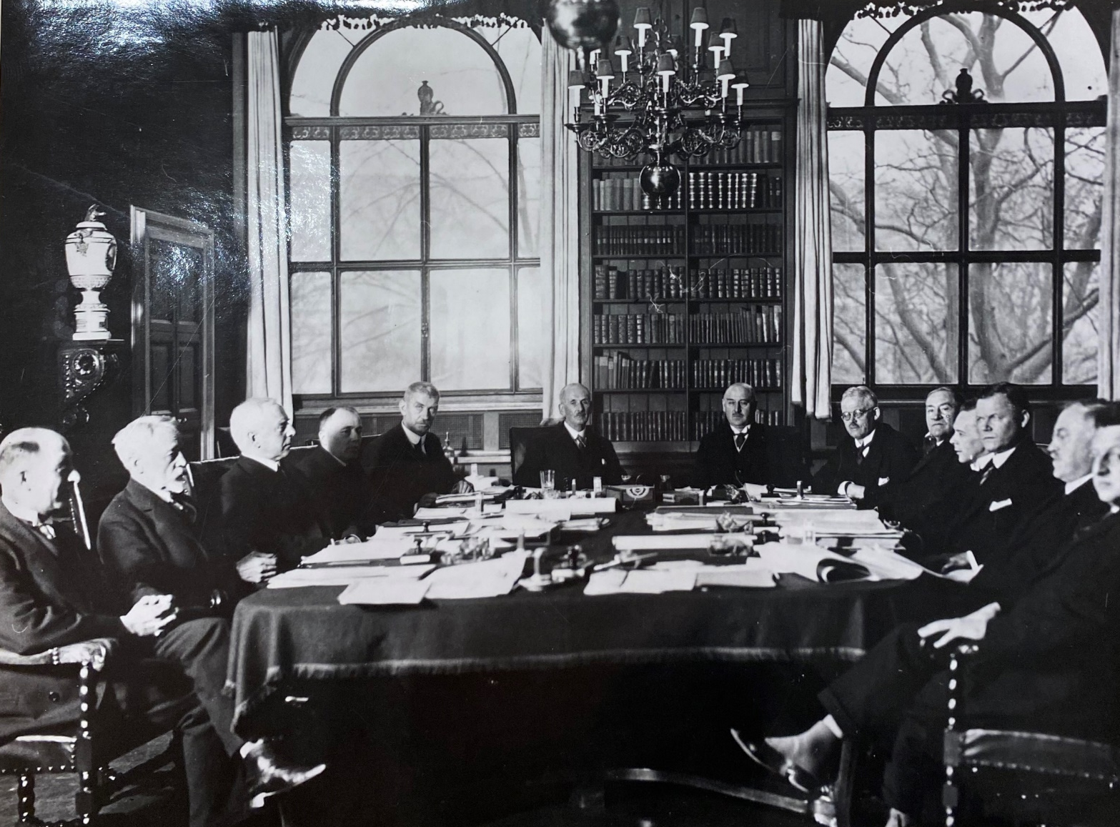
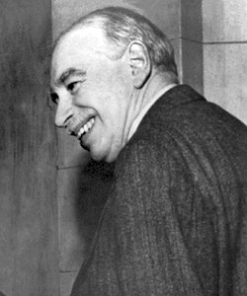
Finally some success: Trial agreement in the aftermath of Central bank meeting in 1931
Danish initiative in front of meeting – suggested trial arrangement
Gold coins no longer important – bank notes and drafts
Economic uncertainty made Riksbank hesitate
In the aftermaths Norway and Denmark concluded a trial agreement in the spring of 1931 – finally some success!
But: in Sept. 1931 Great Britain abandoned the gold standard and all Scandinavian countries followed suit – trial agreement dead
No new attempts materialised. However restoring the Scandinavian Monetary Union was continously debated at the «Nordic» central bank meetings at least until 1939

Slide 12
Small state independence vs. following the great powers
Central banks or governments as driving force?
Bordo and Jonung (2003): efforts to restore the union driven by politicians
No evidence for this
Some scandinavianism
Central banks seem to have been at least as active
The SMU increased independence?
Per H. Hansen (2012): Scandinavian countries «freeriders»; other takes: followed Great Britain
Two-sided
  Wanted US and UK to take the lead; took advice from Norman; followed GB off gold in 1931
  But Sweden back on gold before UK; SMU meetings instrument for countering Great Power dominance

Slide 13
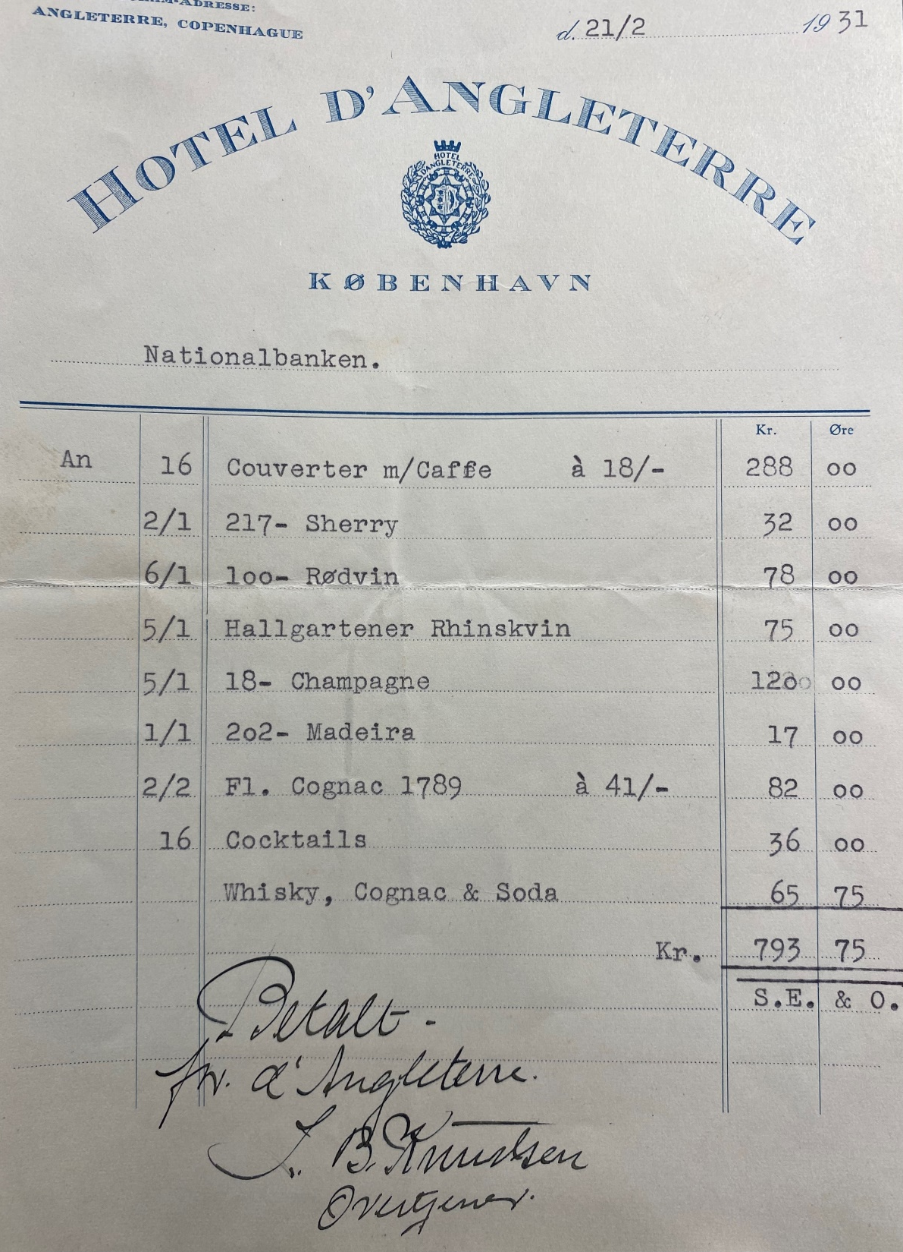
Thank you for your attention

