Slide 1
Monetary unions in history
Hugo Bänziger
Introduction
A financial history conference
1 July 2022
Sofia, Bulgaria
Jointly organised by
The Bulgarian National Bank (BNB)
and eabh (The European Association for Banking and Financial History e.V.)

Slide 2
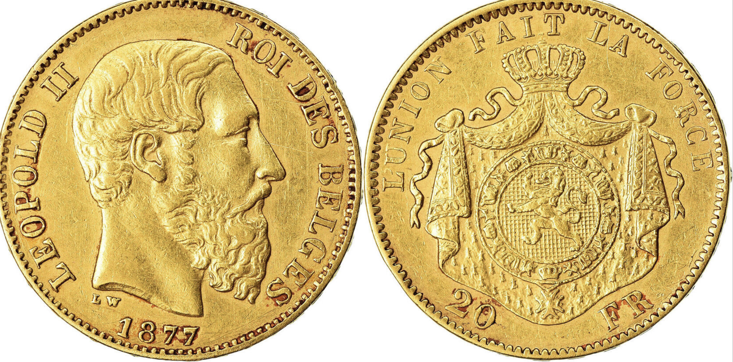
90% Au, 10% Cu; 5.807 g net gold

Slide 3
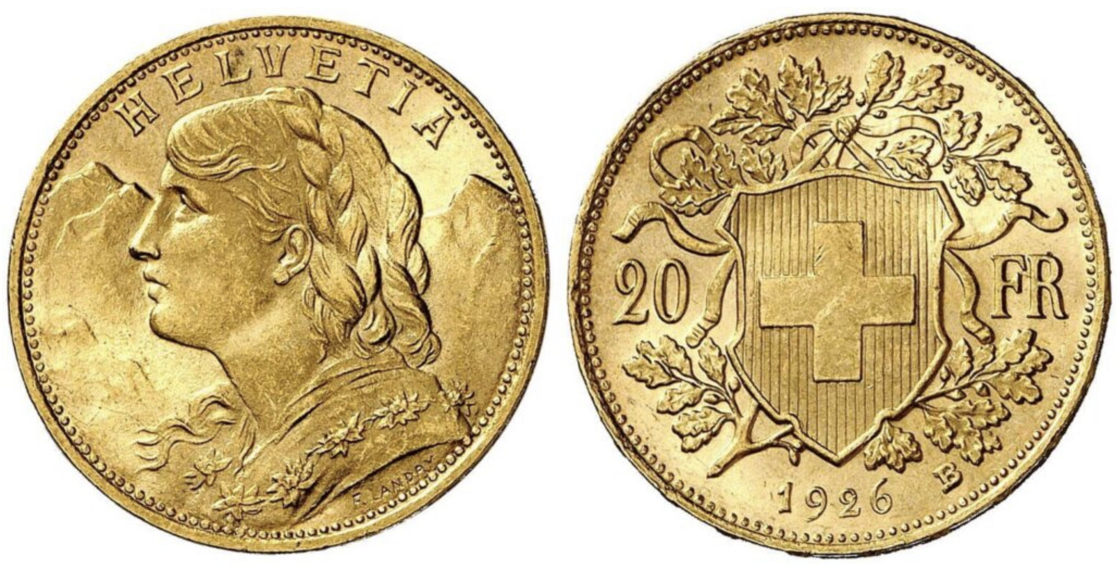
90% Au, 10% Cu; 5.807 g net gold

Slide 4
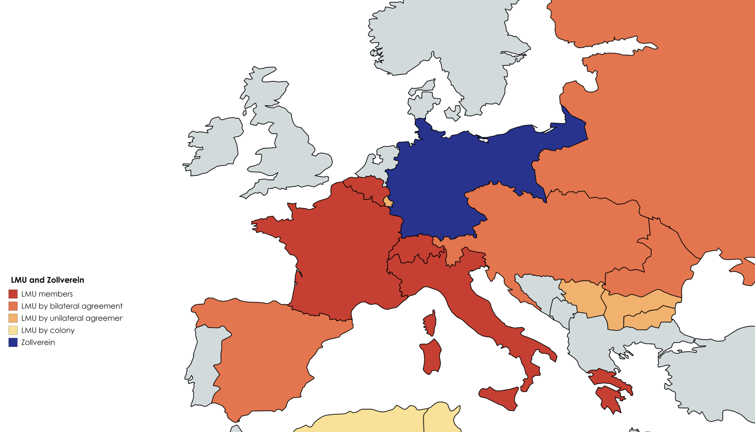

Slide 5
