Slide 1

A Question of Sovereignty: Great Britain, the European Monetary System and the Formation of a European Monetary Union
Juliane Clegg, Department of History, University of Potsdam

Slide 2
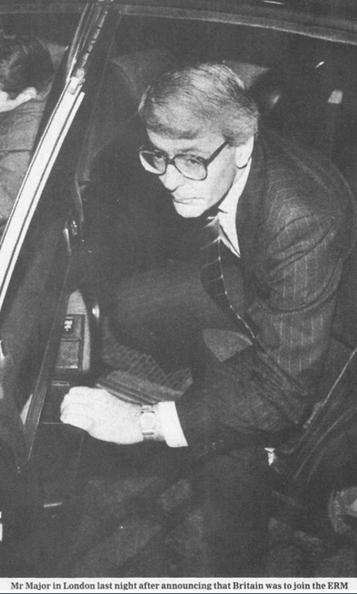
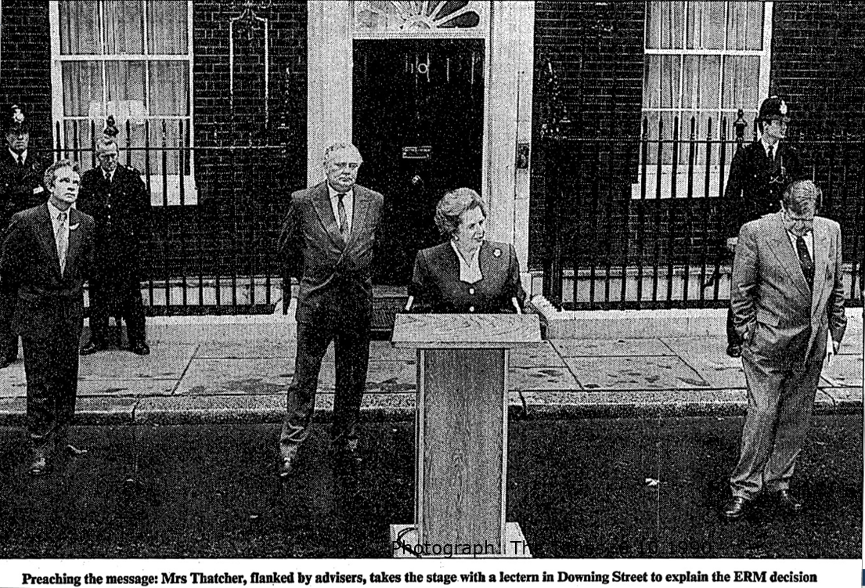
The Times, 6.10.1990.
The Daily Telegraph, 6.10.1990.

Slide 3
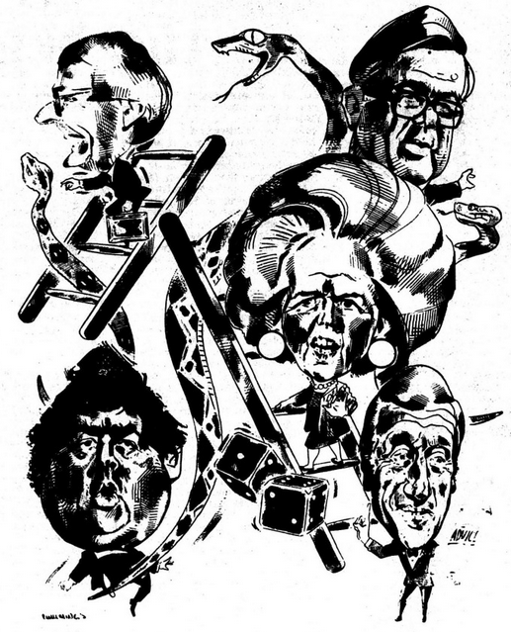
Like snakes and ladders: The political dispute about ERM membership.
Margaret Thatcher and her economic adviser Alan Walters (bottom right) pleading against entry, Foreign Secretary Geoffrey Howe (top right), Chancellor Nigel Lawson (bottom left) and his successor John Major (top left) advocating British participation.
Cartoon: The Financial Times, 6.10.1990.

Slide 4


Slide 5
Structure
Emergence of a 'halfway house': Britain and the foundation of the European Monetary System 1978/79
Growing pressure for external discipline: The Conservatives and the ERM debate from 1985
Sovereigntist backlash: The perspective of Economic and Monetary Union 1988-1992

Slide 6
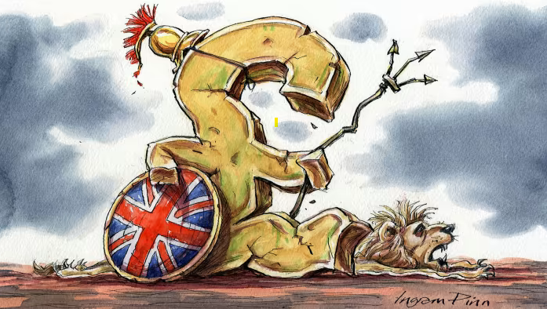
The fiction of monetary sovereignty? Cartoon on sterling’s international power.
The Financial Times, July 2020.

Slide 7
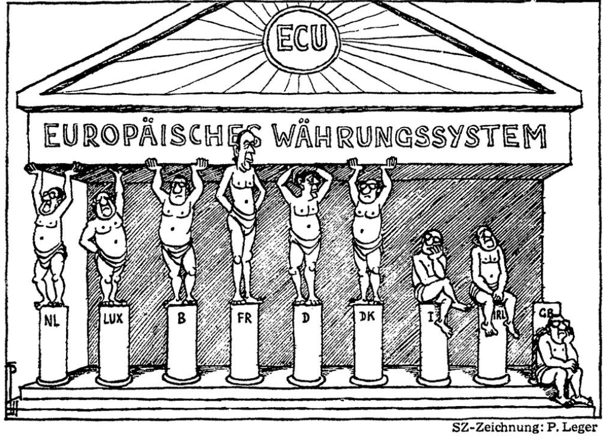
Pillars of the European Monetary System (EMS), 1978/79.
German cartoonist Peter Leger, Süddeutsche Zeitung, 8.12.1978.

Slide 8
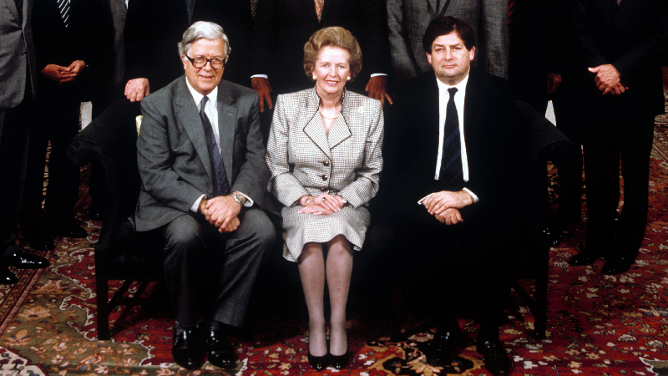
Margaret Thatcher (Prime Minister 1979-1990) with Geoffrey Howe (Foreign Secretary 1983-1989) and Nigel Lawson (Chancellor of the Exchequer 1983-1989) in July 1989

Slide 9
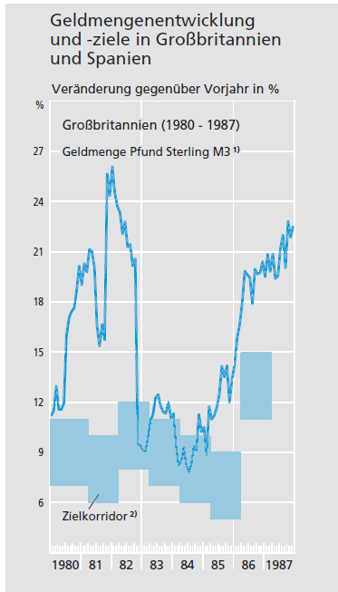
Monetary developments and targets in the UK
Bundesbank, monthly report, January 1998.

Slide 10
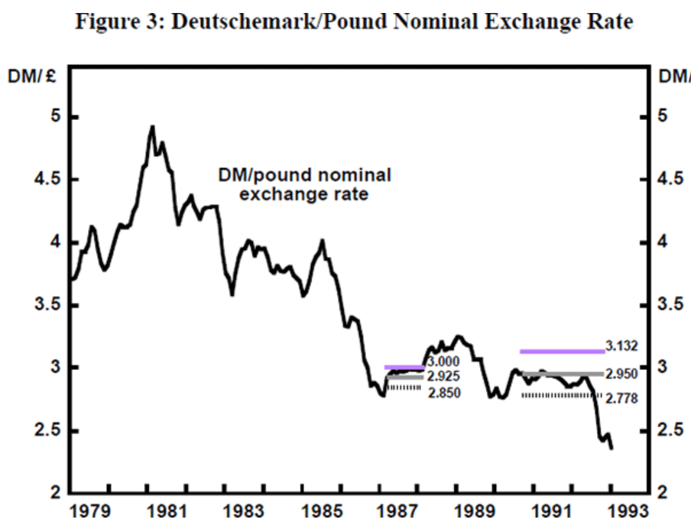
Entry to the Exchange Rate Mechanism (ERM) on 8.10.1990
DM/pound Nominal Exchange Rate, Reserve Bank of Austria, 1993.

Slide 11
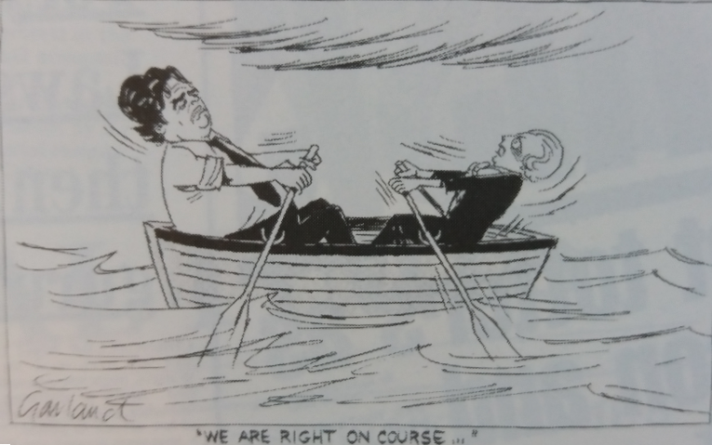
A row over EMS participation: Margaret Thatcher and her Chancellor of the Exchequer Nigel Lawson
Nicholas Garland, Cartoon on EMS policy, The Independent, 22.7.1988.

Slide 12
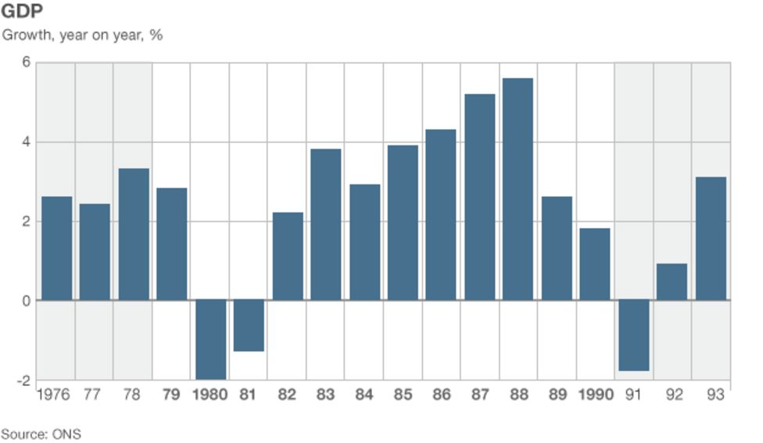
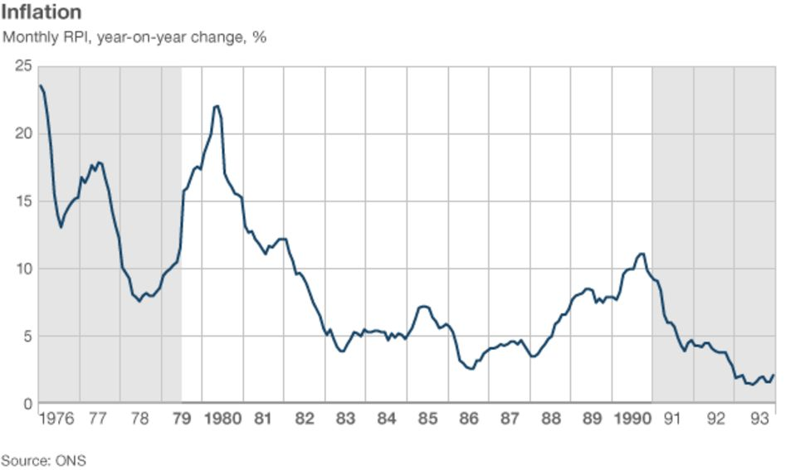
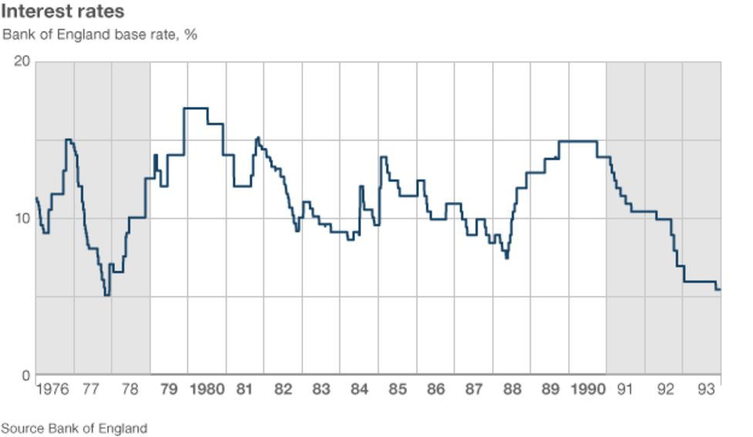
Reduction of interest rates on ERM entry

Slide 13
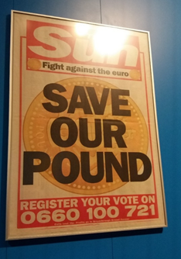
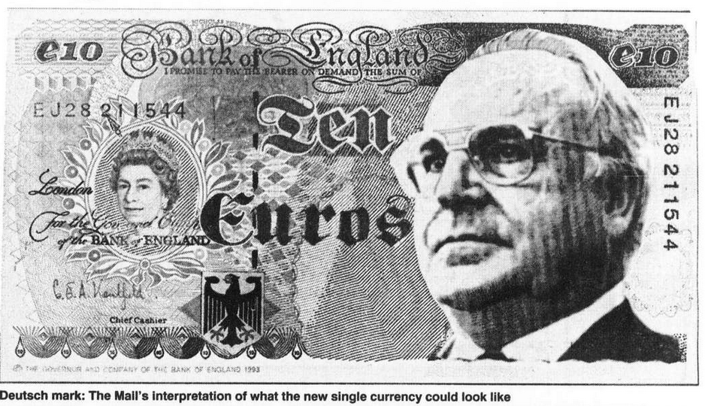
The idea of the Daily Mail what an European currency might look like.
Daily Mail, 5.12.1995.

Slide 14
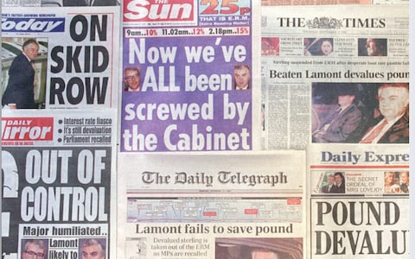

Slide 15
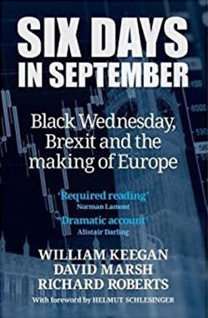
„The ERM adventure, and the nature of the exit, undoubtedly added an important ingredient to the poison which infected Britain’s relationship with the rest of Europe – a poison that tipped the scales in the 2016 referendum decision to leave the European Union.”
William Keegan / David Marsh / Richard Roberts: Six Days in September. Black Wednesday, Brexit and the Making of Europe, London 2017, p. viii.

Slide 16
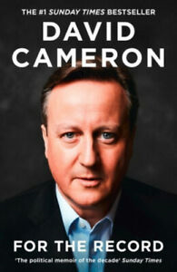
„The euro and the British decision to stay out of it, had produced a new constitutional relationship that was simply not stable or tenable. […]
The simple truth was that the EU was changing – and the Eurozone crisis was driving that change quite rapidly. Britain was in danger of being left in an organisation whose future was being dictated to by an integrationist core, those for whom the euro was their currency.”
David Cameron: For the Record, London 2019, p. 400.

Slide 17



